Slide 1

High-Speed Real-Time VIDEO Streaming
Maksym Holub
Oleh Kuzhylnyi
Oleksandr Ostrianko
Scientific Advisor: Tymofii Khodniev
Department of Design of Electronic Digital Equipment (DEDEC dept.),
Faculty of Electronics, National Technical University of Ukraine "Igor Sikorsky Kyiv Polytechnic Institute“, Kyiv, Ukraine
NTUU KPI

Slide 2
Objectives
Create a custom FPGA-based design with MIPI CSI-2 interface for the development board.
Build a custom Linux distribution based on ARM-part of Xilinx SoC;
Test the connection between Linux distribution and camera;
Include in distribution ARAVIS library and other necessary dependencies;
Build and test a software module on the development board for transmitting a video stream;
Launch the ready-made software module on the Zybo Z7-10 board. Transmit the output video withFullHD resolution stream from the camera to the PC via Ethernet link;

Slide 3
Streaming Technology comparison
Nowadays there exists a large number of competitive video streaming technologies: those based on RTSP, GigE Vision, USB3, and others.The vast majority of them rely on complex interoperated use of multiple protocols at once.

Slide 4
Drawbacks of exiting streaming technologies
USB3 cameras transmit flow to nearest host and do not able to communicate via network layers
RTSP-technology not so much strict in real-time video transmitting unlike GigE vision and uses bandwidth less efficiency and it is an weakly detemined than GigE vision
The RTSP is less predictable in traffic generation sence as shown below

Slide 5
Design Approach
Our solution of buffering delay is relying on a custom flexible realization of MIPI receiver module (MIPI subsystem IP-Core).
Instead of acquiring and buffering the whole video frame before the transmission, it uses buffering only for parts of the frame, allows into reducing the delay
Instead of acquiring and buffering the whole video frame before the transmission, it uses buffering only for parts of the frame, allows into reducing frame buffering delay

Slide 6
MIPI Receive Subsystem
The MIPI CSI-2 RX IP-core subsystem is the main component for creating systems based on the MIPI protocol
D-PHY RX interface is implemented via MIPI D-PHY IP-core and provides PHY protocol layer which compatible with the CSI-2 RX interface
The MIPI CSI-2 RX Controller core receives 8-bit data per line involves support for up to 4 lanes
The final extracted image is made available to the user/processor interface using the AXI4-Stream protocol

Slide 7
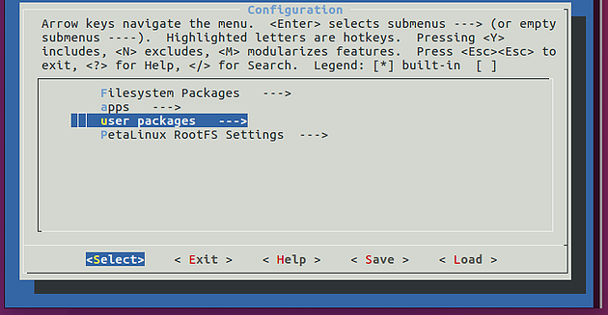
Embedded Linux Design
Embedded Linux has been installed on top of the ARM core part of the Xilinx SoC
Finite Linux distribution is based on the Xilinx PetaLinux Project which involves Yocto and PetaLinux tools for assembly required packages
Zybo Z7-20 base-Linux project from Digilent had been ported for our board that in result became a heard of the Xilinx PetaLinux Project

Slide 8
Demo

Slide 9
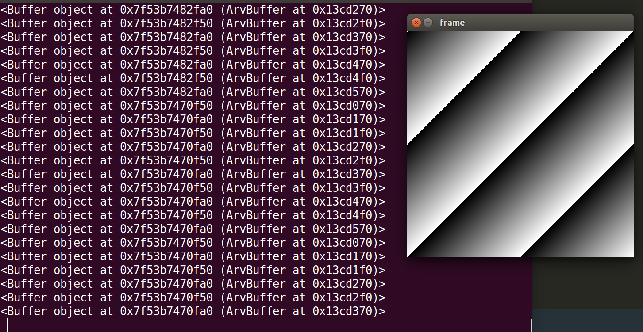
ARAVIS
The GigE Vision standard is proprietary and requires licensing. In spite of this, there exists an open-source ARAVIS library, implementing the GigE Vision interface based on results of reverse engineering of the corresponding protocols
In our implementation the ARAVIS is used for designing a GigE vision compatible standard camera
For realizing a capture frames from a camera we wrote a C program module which uses Video4Linux and ARAVIS API
The ARAVIS viewer is used for view an output video flow

Slide 10
Summary of the design project
The design is complete and meets its objectives and in addition doesn’t have analogs in the world
The design has a modular approach and every component has a specific function
For project improving is possible to change the main camera to another powerful PHY-camera or vice versa use USB camera
Required tools:
ZyboZ7-10 (Zynq-7000 ARM/FPGA SoC Development Board)
Digilent Pcam 5C and ribbon cable for communication
Micro USB cable
Power supply 5V/2A
Cat-5e cable

